Slide 1
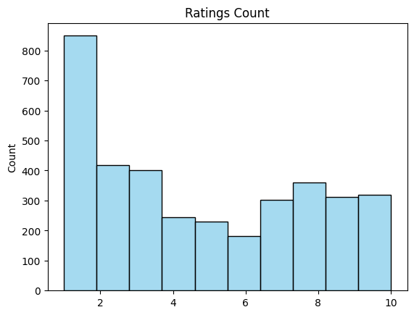
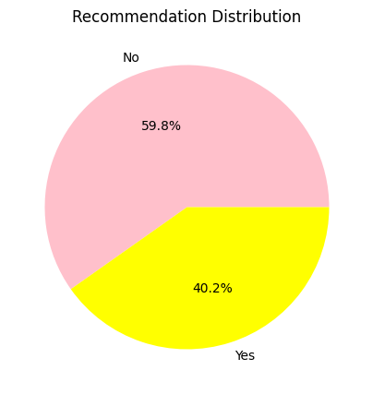
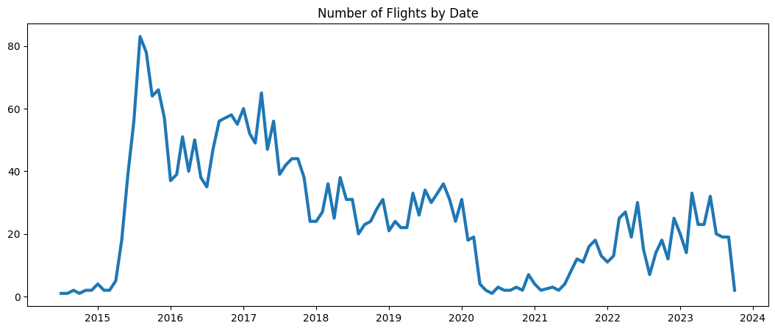
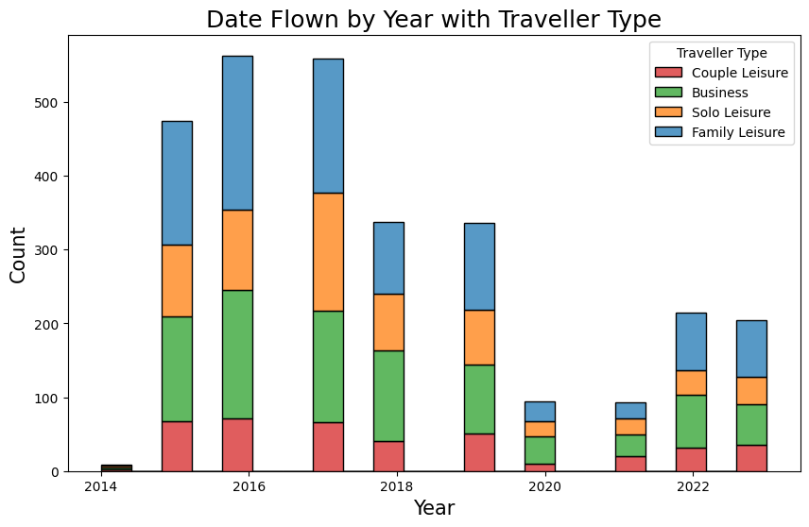
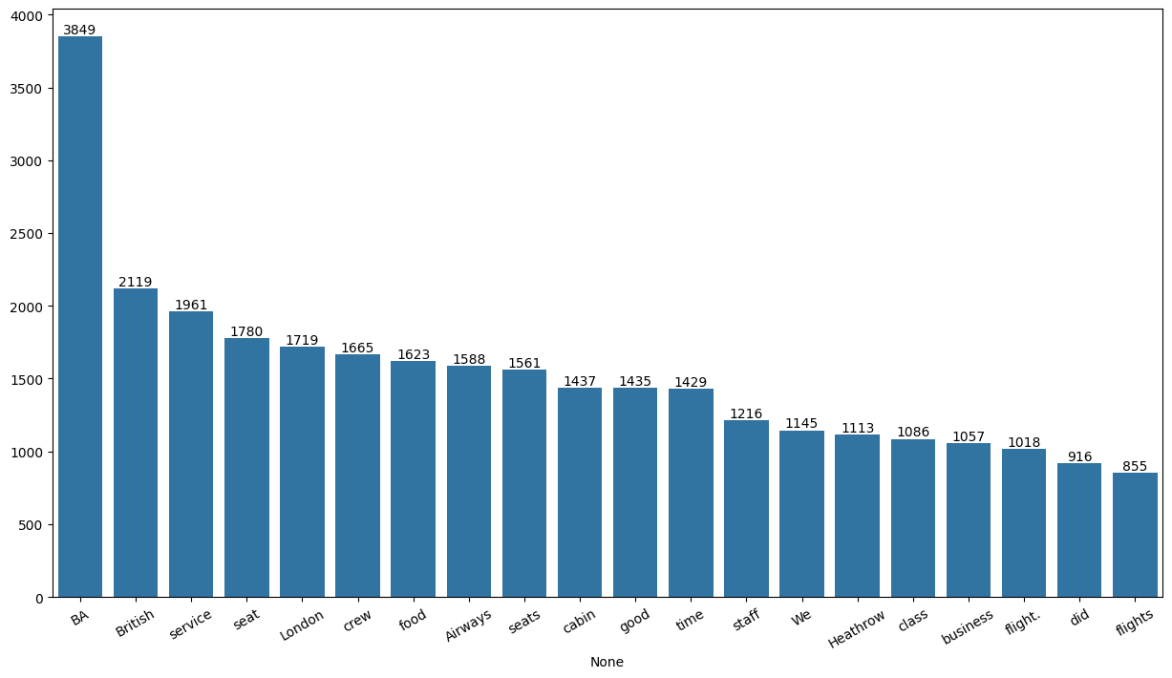
SKYTRAX AIRLINES
Review Analysis

Slide 2
Findings and Recommendations
The Airline has More 1 Star ratings with huge difference
60% of the people doesn’t recommend this airline
There is a huge fall in flights in the year 2021 due to Covid and Pandemic
And there are more no of flights in the sky from October to December could be of Holidays of Halloween and Christmas
The Family leisure and Solo leisure are the most travels in every year. So people who like to go on tours and honeymoons are more
Therefore loosing one ticket due to bad experience can lead to potential loose in more tickets.
The primary target should be service ,seat ,crew and food

